Slide 1
OpenStreetMap for Slow Travellers

Slide 2
OpenStreetMap is everywhere

Slide 3
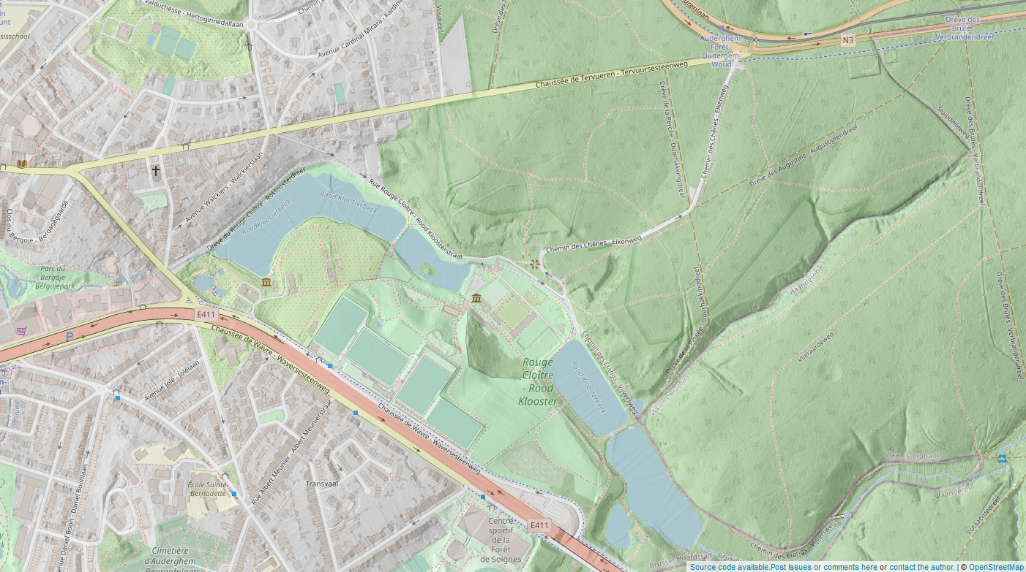
Notes:
When I first started talking about OpenStreetMap, often people had never heard about it
Now, things have changed
But a challenge remains: people are using OpenStreetMap and don’t realize it
https://play.osm.be/historischekaart.html#16/50.8926/4.0187/OSMorg-AIVHillshadesoftVL

Slide 4
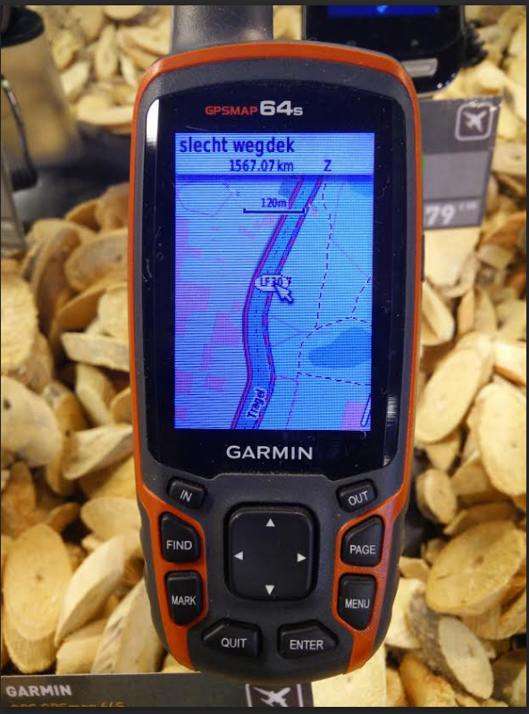
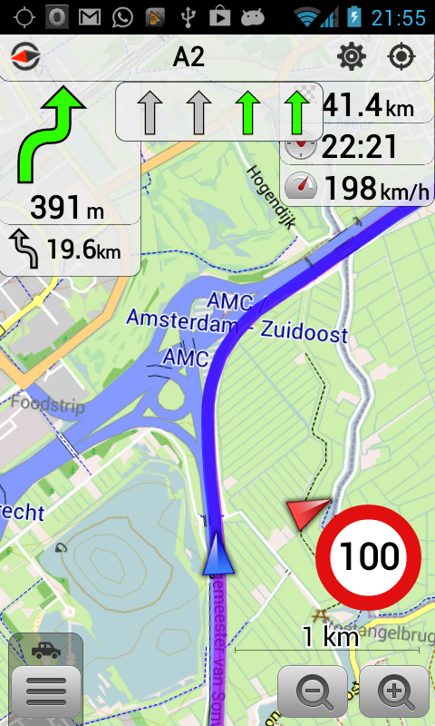
Notes:
But these days our data is everywhere

Slide 5
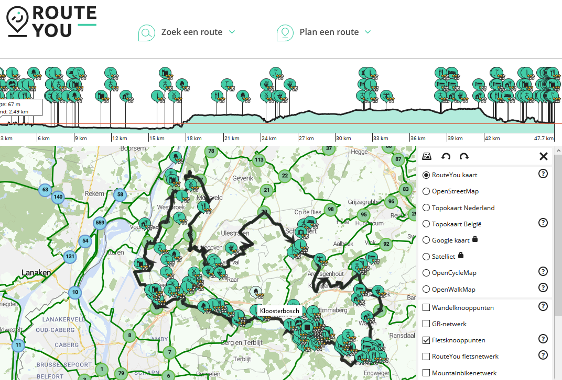
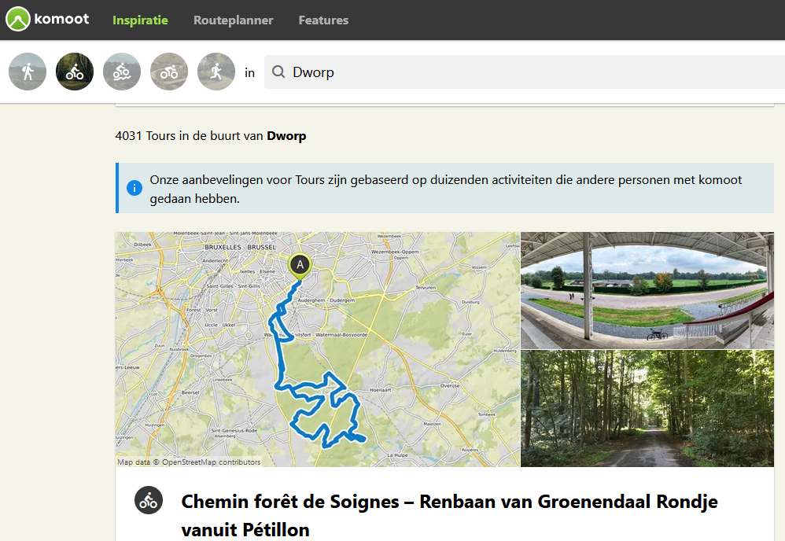
Notes:
It’s used by RouteYou and Komoot and similar
And also by default on all Facebook maps – behind Amazon delivery – used by anyone who plays pokemongo

Slide 6
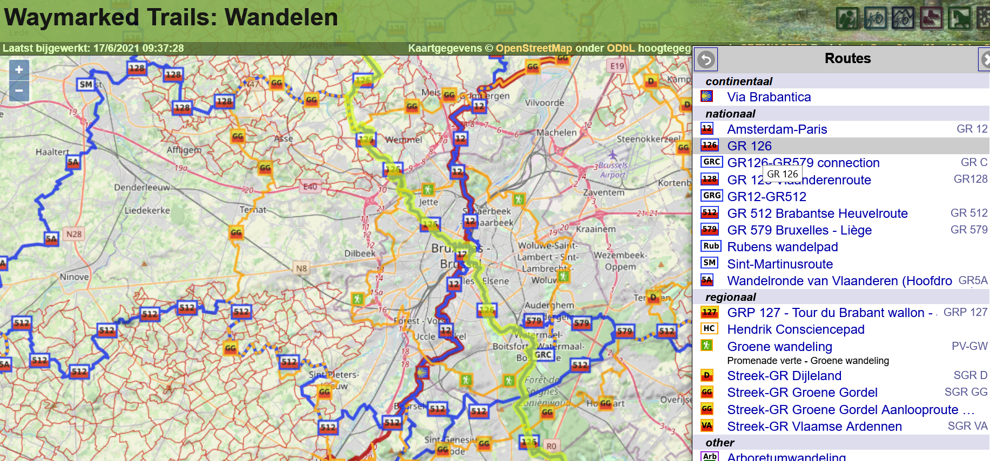
Notes:
And for example here, all the used data is just OSM data, nicely renderen

Slide 7
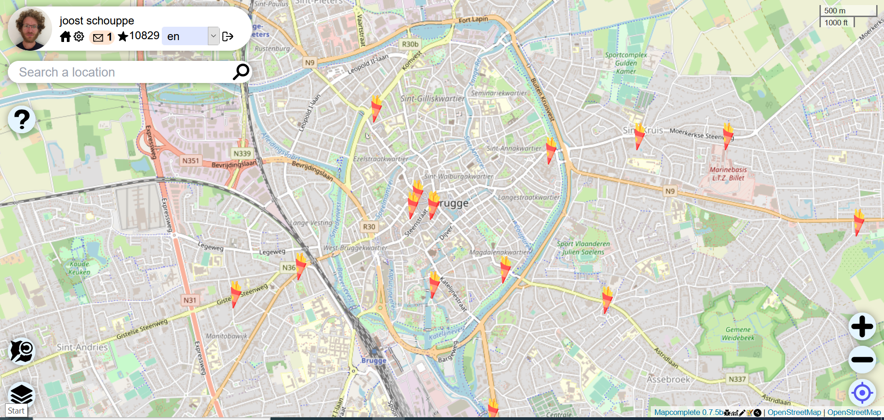
Notes:
People usually just see our background map
But fail to see the hidden depth of the data
For example, we can find all the fritures in Belgium

Slide 8
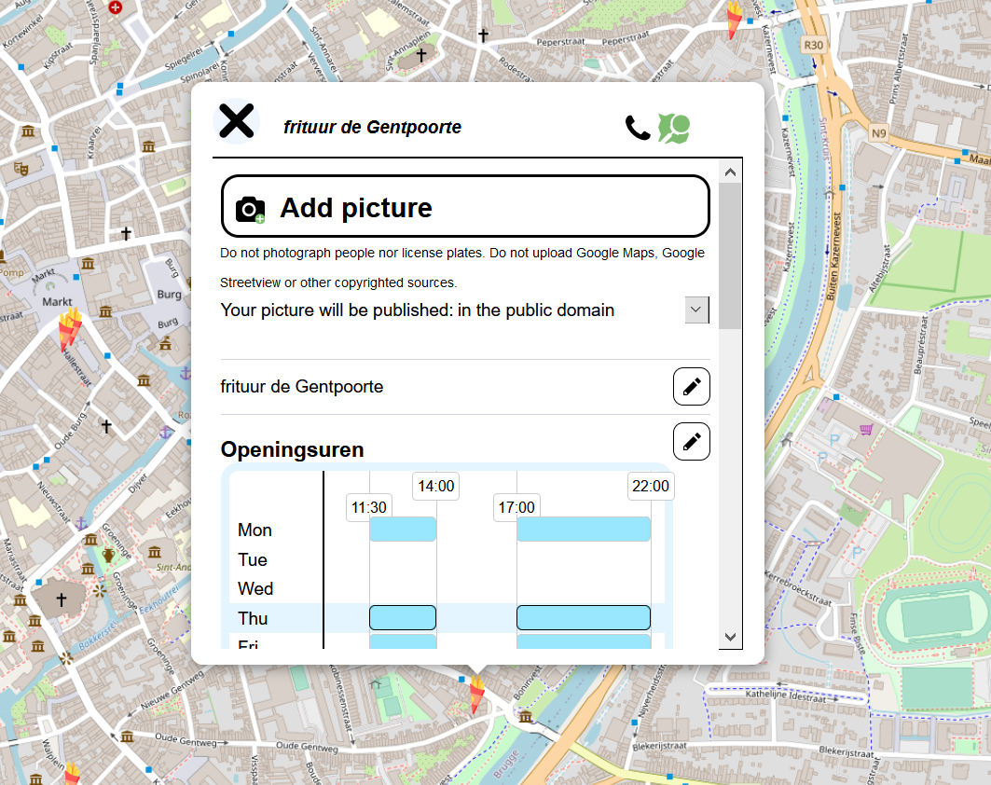
Notes:
But even add their phone number, their opening hours or add a picture!

Slide 9
Why is it everywhere?

Slide 10
What it is and what it isn’t
Freedom to use data
● As long as you attribute
● As long as you give back improvements
● As long as you don’t kill community servers
Freedom to add data
● As long as it is verifiable on the ground
● As long as it is somewhat permanent
● As long as no copyright is infringed
Notes:
Because it is free!
When we say free, we mean freedom! All users have the same power
When we say free, we mean “build the tools and make them work”. That means tools may be cost-free for you, but run without a budget. Or they may charge a little or a lot of money

Slide 11
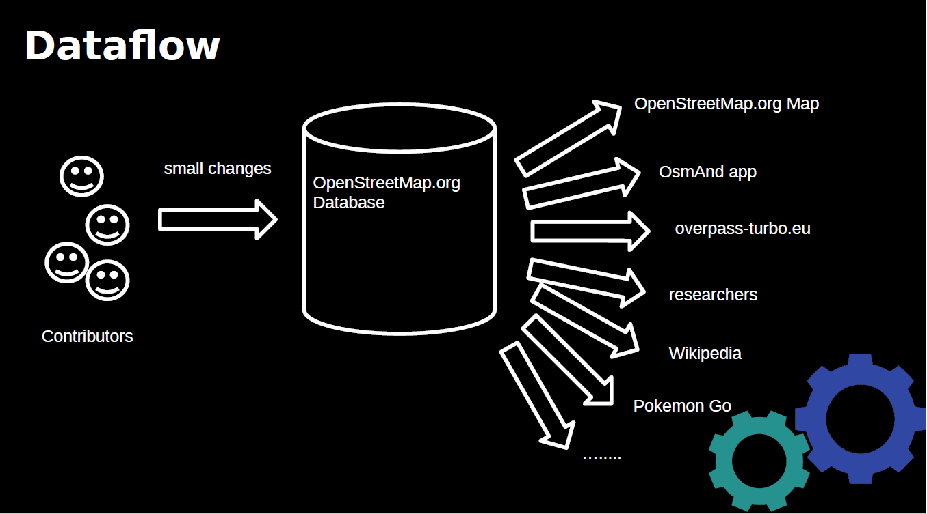

Slide 12
A perfect playground to learn new technical skills
Technically oriented intro to OpenStreetMap

Slide 13
A long hiking story
Find a GPX trail
Analyse it
Walk it!
Collect data on the way
Improve the trail itself
Make a travel map

Slide 14
Find & analyse
Using Waymarkedtrails
Export a file
Import in umap
Open in Osmand
Making some stats with overpass

Slide 15
Overpass examples
https://hackmd.io/b2lZJf0lQiuPdafa2yPbpg?view
Overpass in Umap: http://umap.openstreetmap.fr/nl/map/aed-in-brugge_611158#12/51.2147/3.2173
Notes:
-

Slide 16
Contributing on the road

Slide 17
Hands on – setting up Osmand for contributing
Notes:
Gpx tracking
OSM contributing

Slide 18
Hands on – MapComplete
Notes:
Show some themes
Show the personalised theme
Show the theme builder

Slide 19
Street level imagery

Slide 20
Editing hiking relations
In the web editor
In JOSM

Slide 21
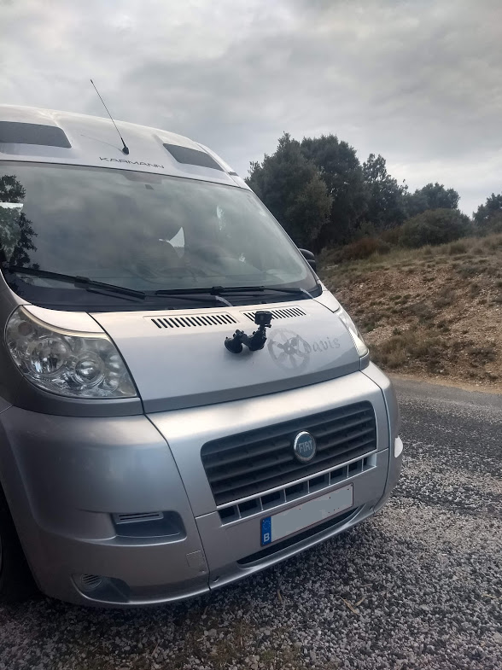
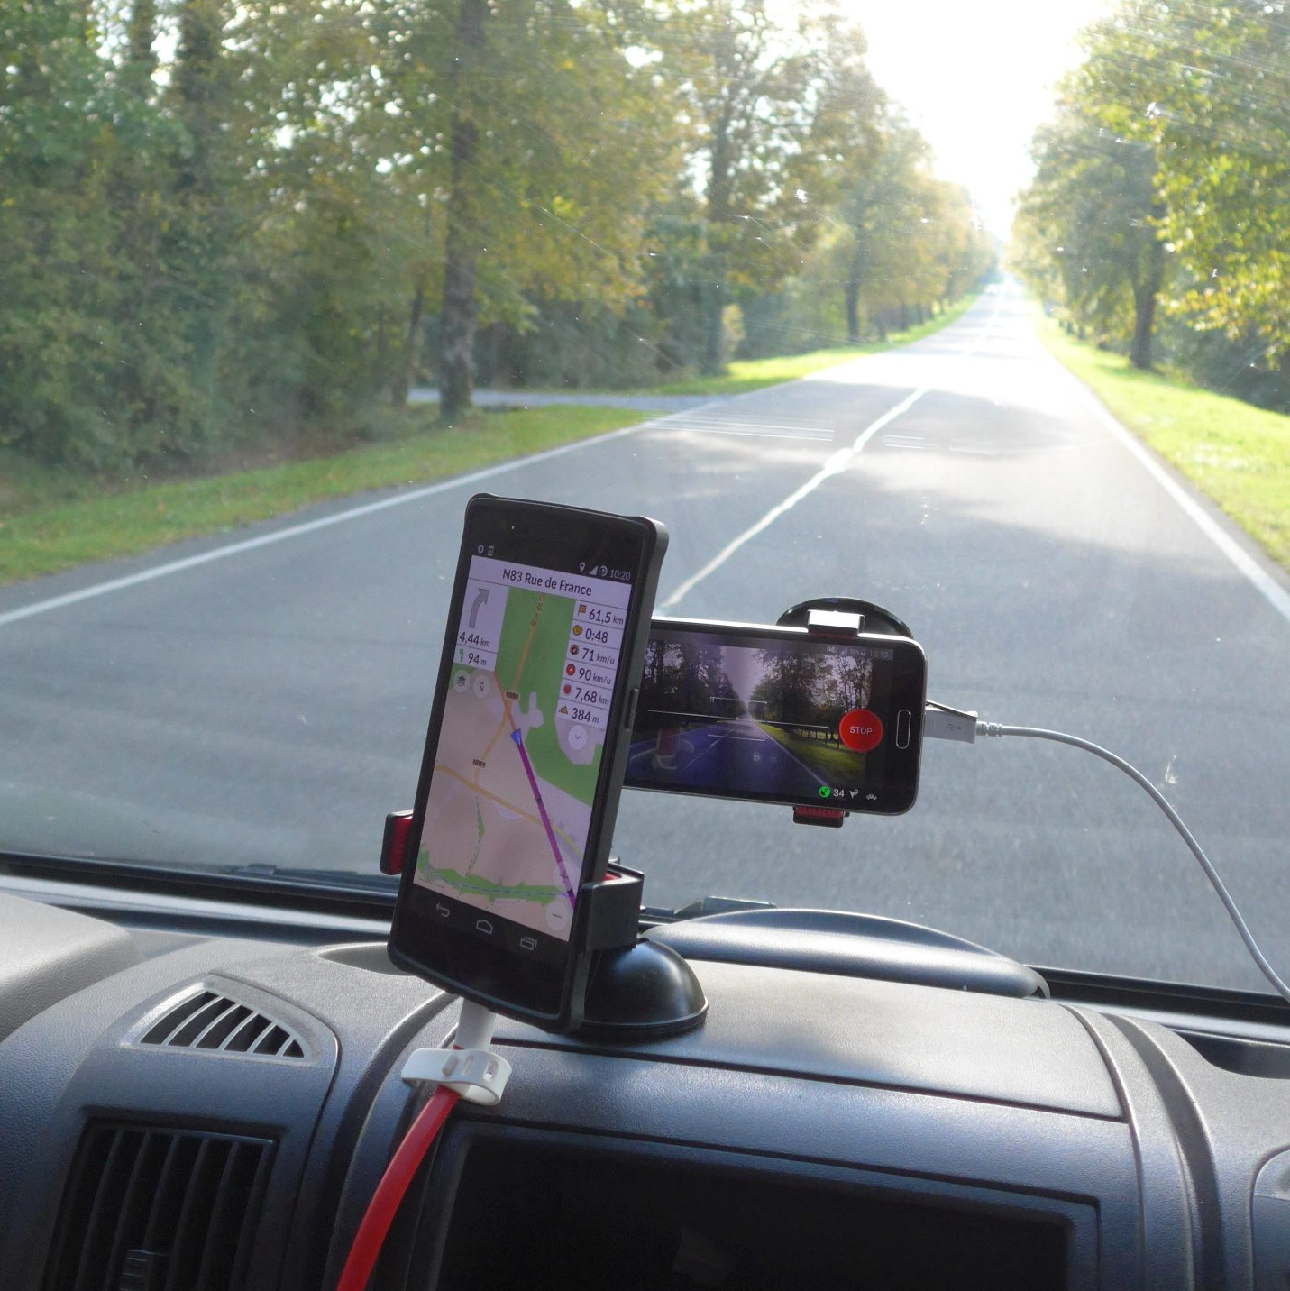
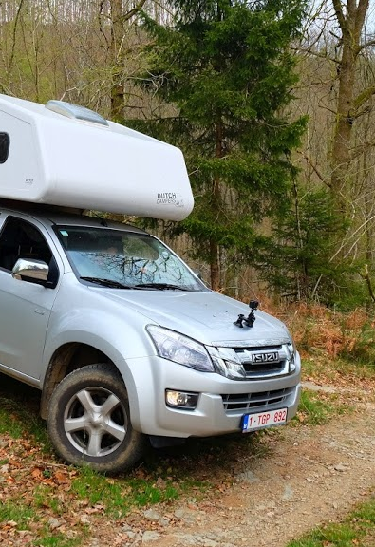
Notes:
https://www.mapillary.com/app/?lat=49.9655482&lng=4.945109&z=17&pKey=149247120556979&focus=photo

Slide 22
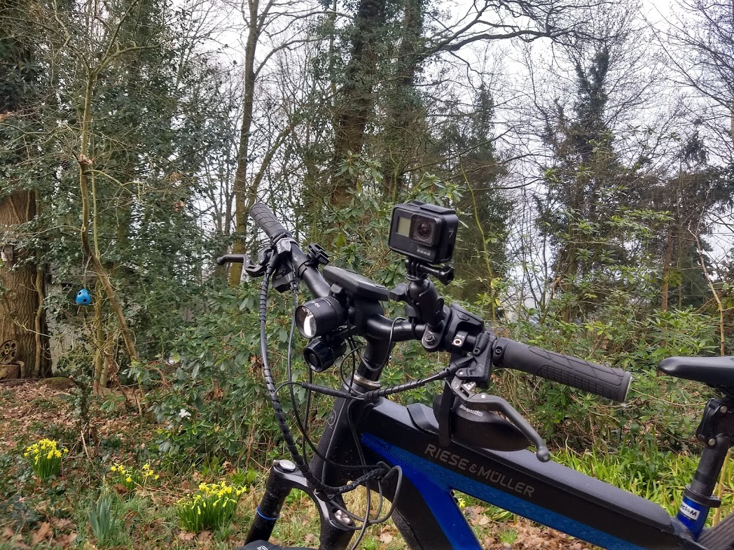
Notes:
https://www.mapillary.com/app/?lat=50.75915114177067&lng=4.262096614973075&z=13.98978307006613&pKey=522114965897270&focus=photo

Slide 23
In conclusion
Steep learning curves!
Many different tools!
We still learn every day
We LOVE to help you ☺
Join the chat or contact community@osm.be

